Slide 1
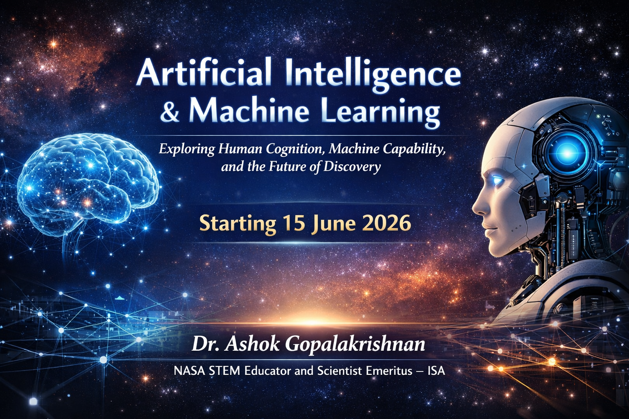
SUMMER INTERNSHIP ON AI & ML 2026
Dr Ashok Gopalakrishnan, Scientist Emeritus,

Slide 2
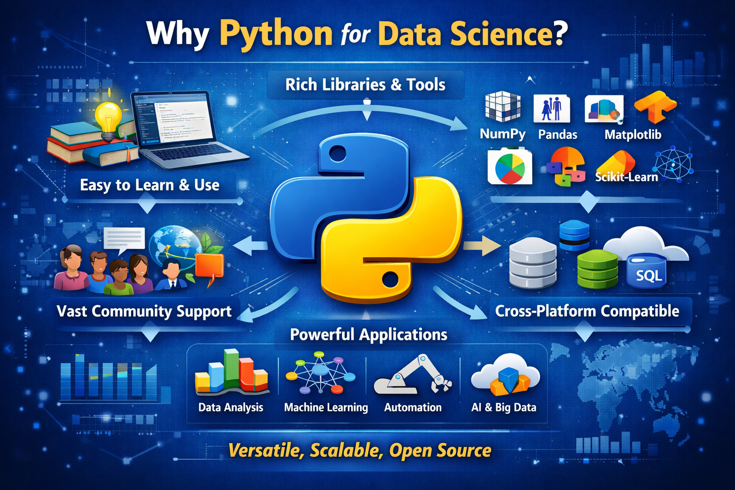
SUMMER INTERNSHIP ON AI & ML 2026

Slide 3
SUMMER INTERNSHIP ON AI & ML 2026
“Welcome to Day 2 of our workshop. Today, we step into the world of Python for Data Science — the language that has become the backbone of modern analytics, machine learning, and AI.
Why Python?
Because it is:
Simple and readable — easy for beginners, powerful for experts.
Rich in libraries — from NumPy and Pandas for data handling, to Matplotlib and Seaborn for visualization, and Scikit‑Learn for machine learning.
Community‑driven — supported by millions of developers, researchers, and data scientists worldwide.
Easy to Learn & Use: Laptop with Python code and lightbulb.
Cross‑Platform Compatible: Cloud, database, and SQL icons.
Powerful Applications: Data Analysis, Machine Learning, Automation, AI & Big Data.
“NASA ISRO etc uses Python for mission data analysis, and finance firms rely on it for risk modeling — it’s everywhere.”
Python’s versatility — it’s not just a programming language, but a complete ecosystem for data‑driven innovation.

Slide 4
SUMMER INTERNSHIP ON AI & ML 2026
Python’s syntax is close to natural language — fewer symbols, more readability.
Ideal for students transitioning from non‑programming backgrounds.
Example: for value in data: is intuitive compared to complex syntax in other languages.
Rich Libraries & Tools
NumPy: Efficient numerical operations and array handling.
Pandas: Data manipulation and cleaning with Data Frames.
Matplotlib / Seaborn: Visualization and storytelling through graphs.
Scikit‑Learn / TensorFlow: Machine learning and deep learning frameworks.
Vast Community Support
Millions of developers contribute tutorials, forums, and open‑source packages.
Continuous updates ensure compatibility with new technologies.
Example: Stack Overflow, GitHub, and Kaggle communities provide instant help.

Slide 5
SUMMER INTERNSHIP ON AI & ML 2026
Cross‑Platform Compatibility
Works seamlessly on Windows, macOS, Linux, and cloud environments.
Integrates with SQL, Excel, APIs, and web frameworks.
Example: Data pipelines can move from local analysis to cloud deployment without rewriting code.
Powerful Applications
Data Analysis: Business intelligence, scientific research, social analytics.
Machine Learning: Predictive modeling, recommendation systems.
Automation: Workflow optimization, data scraping, report generation.
AI & Big Data: Natural language processing, image recognition, large‑scale analytics. Teaching Tip: Relate each application to real‑world examples — e.g., NASA’s use of Python for mission telemetry analysis.

Slide 6
SUMMER INTERNSHIP ON AI & ML 2026
What most people don’t know about Python is that it can be used as a scripting language. In scripting, the code is written in script form and gets executed. So the code is read and interpreted by the machine and errors are checked during runtime. After the code is checked, it can be used many times. It is also possible to automate specific tasks in a problem by automation.
Python can be employed in small, large, online or offline projects. It is used to develop GUI and desktop applications. It’s ‘Tkinter’ library enables simple and rapid application development. This programming language is also used in game development where the logic is written using a module ‘pygame’ which can also run on android devices.
This language is an excellent tool for validating the products or ideas for established enterprises. Python has numerous built-in testing frameworks that deal with debugging and rapid workflows. Its tools and modules such as Selenium and Splinter work to make things easier. Python also supports cross-platform and cross-browser testing with frameworks like PyTest and Robot framework.

Slide 7
SUMMER INTERNSHIP ON AI & ML 2026
NumPy is a core Python library for numerical computing, built for handling large arrays and matrices efficiently. It is significantly faster than Python's built-in lists because it uses optimized C language style storage where actual values are stored at contiguous locations (not object reference).
ndarray object: N-dimensional array for fast numerical operations.
Vectorized operations: Perform element-wise calculations without loops.
Broadcasting: Operate on arrays of different shapes.
Linear algebra functions: Matrix operations like multiplication and inversion.
Statistical functions: Mean, median, standard deviation.
Integration: Works with Pandas, SciPy and scikit-learn.

Slide 8
SUMMER INTERNSHIP ON AI & ML 2026
Why Learn NumPy?
Executes vectorized operations 10 to 100 times faster than standard Python loops.
Uses homogeneous arrays to store large datasets more compactly than Python lists.
Provides optimized functions for linear algebra, Fourier transforms and matrix manipulations.
Includes robust tools for statistics, random number generation and missing data management.
Expresses complex math in single-line commands, eliminating the need for manual, nested loops.

Slide 9
SUMMER INTERNSHIP ON AI & ML 2026
Example
import numpy as np
n = np.array([9,3,3,5])
print(n.mean()) # Calculating mean
Output
5.0

Slide 10
SUMMER INTERNSHIP ON AI & ML 2026
Python
print("Hello world.")
vs.
Java
public class HelloWorld {
public static void main (String[ ]args) {
System.out.println.("Hello world");
}
}
SIMPLICITY OF
PYTHON VS JAVA

Slide 11
SUMMER INTERNSHIP ON AI & ML 2026
It’s easy to read. Python code uses English keywords rather than punctuation, and its line breaks help define the code blocks. In practice, this means you can identify what the code is designed to do simply by looking at it.
It’s open source. You can download the source code, modify it, and use it however you want.
It’s portable. Some languages require you to modify code to run on different platforms, but Python is a cross-platform language, which means you can run the same code on any operating system with a Python interpreter.
It’s extendable. Python code can be written in other languages (such as C++), and users can add low-level modules to the Python interpreter to customize and optimize their tools.
It has a broad standard library. This library is available for anyone to access and means that users don’t have to write code for every single function—they can access built-in modules that help with issues in everyday programming and more

Slide 12
SUMMER INTERNSHIP ON AI & ML 2026
Python is the top preferred language for data science and research. Since its syntax is easily understandable and adaptable, people with little-to-no development experience can easily learn Python and use it to manipulate data for research, reporting, predictable or regression analyses, and more. Collecting and parsing data can be a time-consuming task for data scientists. Python is also one of the top languages for training machine learning (ML) models.
Through specific algorithms, these models can analyze and identify patterns in data to make predictions or decisions based on that data. They also constantly evolve based on outputs of previous datasets to confront new variables. Data scientists and developers training ML models often utilize libraries, such as NumPy, Pandas, and Matplotlib, to automate functions like cleaning, data transformation, and visualization.

Slide 13
SUMMER INTERNSHIP ON AI & ML 2026
Python can also be found in some of the most complex, artificial intelligence (AI) technologies—and it’s actually one of the preferred languages for AI. Python’s concise and readable code allows developers to create consistent, reliable systems, and its vast library provides a number of frameworks like PyBrain, which offers developers powerful algorithms for machine learning tasks. Plus, Python’s visualization capabilities can help convert these large datasets for AI or ML into comprehensible graphs or reports. Interestingly enough, OpenAI, the artificial intelligence research lab, utilizes the Python framework, Pytorch, as their standard framework for deep learning, which trains its AI systems.
Python is widely used in:
Satellite data processing (e.g., Sentinel, Landsat imagery)
Astrophysics simulations (astropy, spacepy)
Orbital mechanics (poliastro)
Telemetry analysis for spacecraft
Example: Calculating a satellite orbit with poliastro

Slide 14
SUMMER INTERNSHIP ON AI & ML 2026
from astropy import units as u
from poliastro.bodies import Earth
from poliastro.twobody import Orbit
# Define an orbit: 7000 km semi-major axis, 0.01 eccentricity
orbit = Orbit.from_classical(Earth, 7000 * u.km, 0.01 * u.one,
98.7 * u.deg, 0 * u.deg, 0 * u.deg, 0 * u.deg)
print(orbit)
ABOVE IS A SAMPLE CODE IN PYTHON USAGE IN SPACE EXPLORATION

Slide 15
SUMMER INTERNSHIP ON AI & ML 2026
NASA, one of the most technologically advanced organizations in human history, has woven Python into nearly every layer of its modern operations, from mission control and spacecraft navigation to image processing, simulation, AI-driven exploration, and planetary research. What began as a tool favored by data scientists has evolved into a critical instrument in the space agency’s technological orchestra.
NASA’s earliest missions relied on low-level programming languages such as FORTRAN, C, and Assembly, tools that allowed engineers to squeeze maximum performance from limited onboard computers. These languages were fast and efficient but extremely difficult to write, debug, and scale for modern missions.
As spacecraft became more sophisticated and missions became longer and more autonomous, NASA required a language that was:
1. Easy to read and maintain for multidisciplinary teams
2. Flexible enough for rapid prototyping and testing
3. Equipped with libraries for mathematics, physics, machine learning, and data visualization
4. Compatible with existing systems and adaptable to cloud and ground-based infrastructures

Slide 16
SUMMER INTERNSHIP ON AI & ML 2026
For example, in planning interplanetary missions such as Mars landings or lunar orbits, Python is used to:
• Model gravitational interactions between celestial bodies
• Optimize fuel usage for trajectory corrections
• Simulate orbital dynamics under varying conditions
• Plan docking procedures with other spacecraft
• Coordinate timing with Earth-based communication stations
Libraries such as Astropy, Poliastro, and Orekit allow engineers to write elegant code that solves highly complex equations of celestial mechanics with precision. These calculations are no longer confined to specialized software — they are accessible, auditable, and adaptable through Python.

Slide 17
SUMMER INTERNSHIP ON AI & ML 2026
Python in the Mars Missions
NASA’s Mars exploration programs have become some of the most sophisticated examples of human achievement in space exploration. The Perseverance rover, for instance, required intricate coordination between Earth-based mission control and autonomous onboard systems. Python played a vital role in:
• Processing incoming data from the rover’s cameras and sensors
• Running image analysis to detect terrain obstacles and scientifically valuable targets
• Simulating rover movement in Mars-like virtual environments
• Predicting weather patterns on Mars for safe navigation and energy optimization
• Visualizing mission data in real time for engineers and scientists
Python’s machine learning libraries are also used in autonomous navigation algorithms, enabling Perseverance to make decisions without waiting for Earth-based commands, a necessity due to the long communication delay between Earth and Mars.

Slide 18
SUMMER INTERNSHIP ON AI & ML 2026
As missions extend deeper into space and scientific problems grow exponentially complex, traditional computing may no longer be sufficient. NASA is actively exploring quantum computing, and Python is already at the heart of this exploration.
Python interfaces with quantum simulators and hardware through libraries like Qiskit and Cirq, enabling NASA researchers to:
• Simulate complex orbital dynamics that classical computers struggle with
• Optimize trajectories for multi-planet missions
• Model materials for next-generation spacecraft
• Solve complex signal processing problems in deep space communication
Python provides the unifying interface between classical and quantum computing, making these experiments practical today.
As NASA collaborates with international partners and commercial entities, cybersecurity becomes crucial. Python is a dominant language in security testing, monitoring, and threat analysis.

Slide 19
SUMMER INTERNSHIP ON AI & ML 2026
NASA’s Python usage is not hypothetical, it’s everywhere:
• Mars Perseverance Rover: Python scripts process and analyze terrain data to guide rover autonomy.
• James Webb Space Telescope: Data reduction pipelines in Python calibrated and reconstructed images of the early universe.
• Artemis Mission Planning: Python simulations model complex trajectories and lunar logistics.
• Earth Science: Python powers climate monitoring dashboards used globally.
• JPL Flight Software Testing: Python validates spacecraft behavior before launch.

Slide 20
SUMMER INTERNSHIP ON AI & ML 2026
When people imagine astronauts, they picture humans in suits floating in zero gravity. But one of the most important astronauts of our time is silent, invisible, and made entirely of code. Python enables humanity to model new worlds, guide machines across alien landscapes, and see deeper into the cosmos than ever before.
NASA’s use of Python is not just a story about technology. It’s a story about human ingenuity, collaboration, and curiosity. It shows how a simple language, built to be readable and open, became a cornerstone of the most ambitious scientific enterprise in history.
Python has become NASA’s invisible co-pilot, helping humanity not just explore space, but understand it.

Slide 21
SUMMER INTERNSHIP ON AI & ML 2026
NumPy – Numerical Computing
Foundation for scientific computing in Python.
Provides fast, memory‑efficient arrays and mathematical functions.
Example:
python
mport numpy as np
data = np.array([1, 2, 3, 4])
print(np.mean(data)) # Output: 2.5
Pandas – Data Handling & Cleaning
Built on NumPy; ideal for tabular data (DataFrames).
Handles missing values, filtering, grouping, and merging.
Example:
python
import pandas as pd
df = pd.read_csv("data.csv")
print(df.describe())

Slide 22
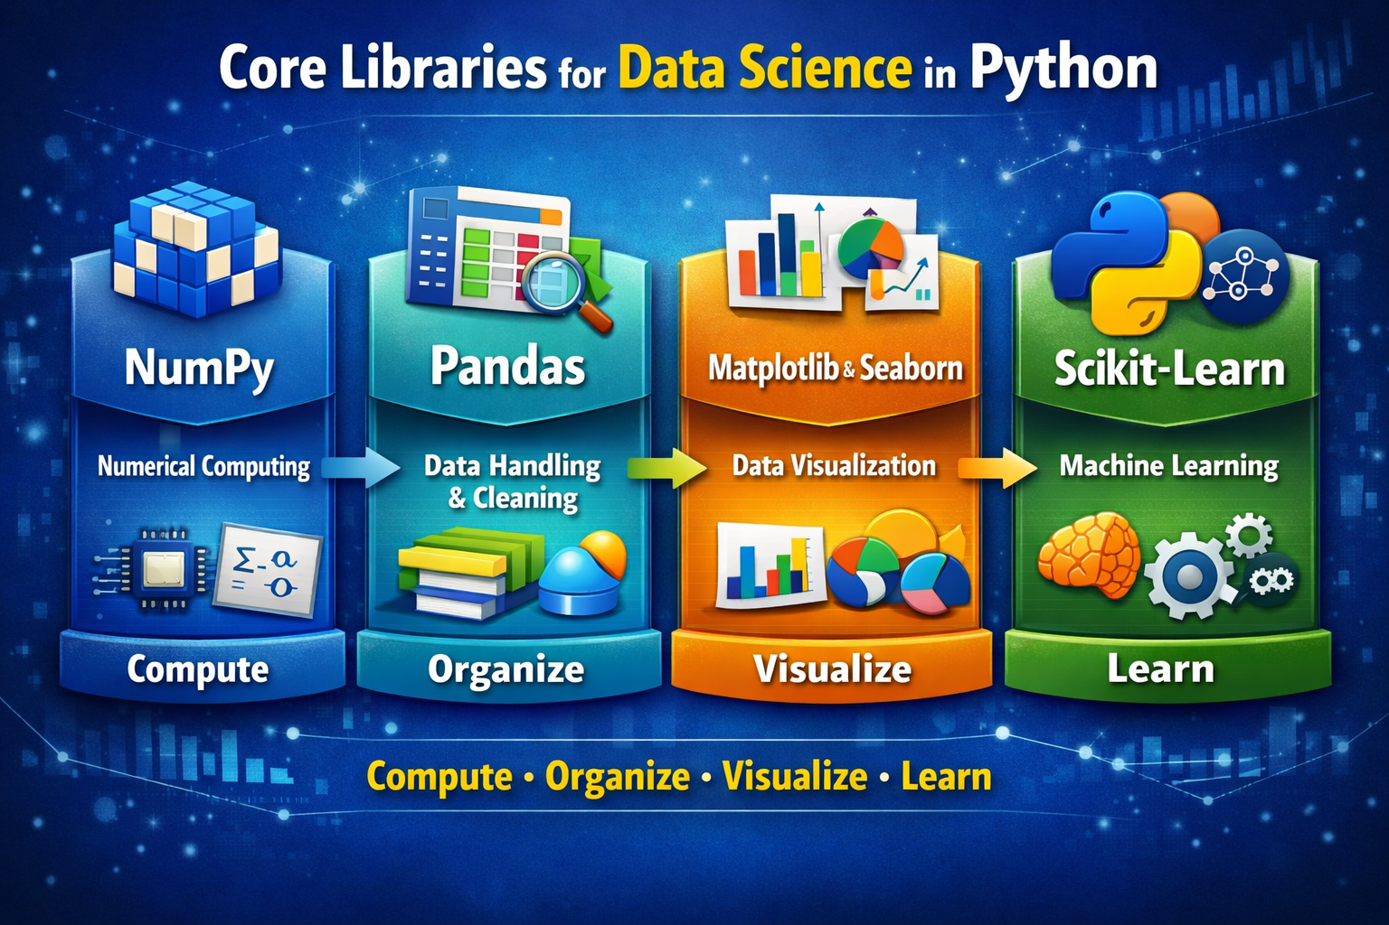
SUMMER INTERNSHIP ON AI & ML 2026
NumPy is the calculator, Pandas is the spreadsheet, Matplotlib/Seaborn are the storytellers, Scikit‑Learn is the analyst.

Slide 23
SUMMER INTERNSHIP ON AI & ML 2026
The Data Science Workflow
Collect
Gather data from CSV, Excel, APIs, sensors, or databases.
Example: pd.read_csv("data.csv")
Clean
Handle missing values, duplicates, and inconsistent formats.
Example: df.dropna() or df.fillna(value)
Explore
Summarize and visualize data to detect patterns.
Example: df.describe() and sns.pairplot(df)
Model
Apply machine‑learning algorithms for prediction or classification.
Example: model.fit(X_train, y_train)
Communicate
Present findings through dashboards, reports, or presentations.
Example: plt.show() or exporting results to Excel/PowerPoint.
Summary Line
“Python transforms data into decisions through a structured, repeatable workflow.”

Slide 24
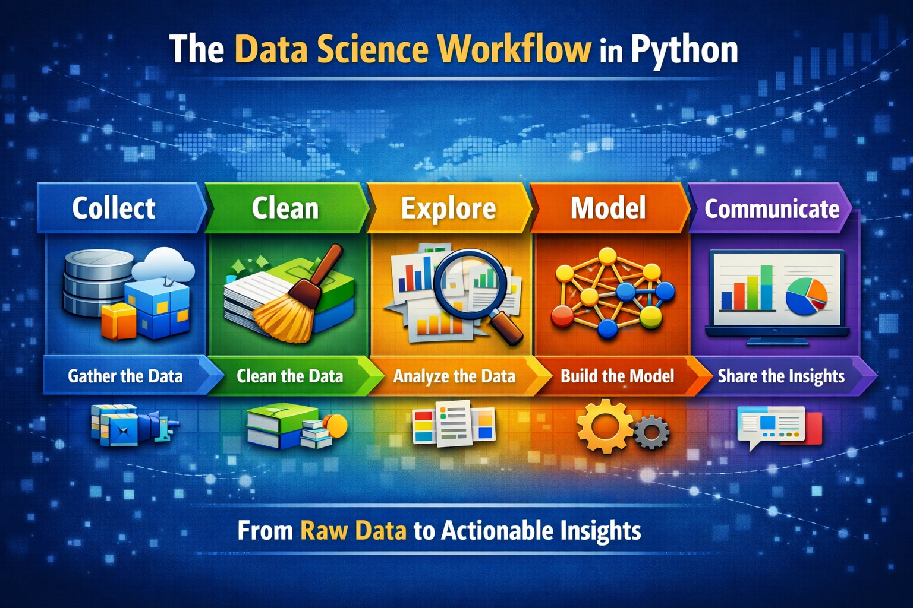
SUMMER INTERNSHIP ON AI & ML 2026

Slide 25
SUMMER INTERNSHIP ON AI & ML 2026
Collect (📥): Show how Python reads CSVs, Excel, APIs, or sensor data. Relate to space telemetry or student datasets.
Clean (🧹): Demonstrate handling missing values and duplicates. Stress “clean data = reliable insights.”
Explore (🔍): Use Pandas .describe() and Seaborn plots to uncover patterns. Encourage curiosity.
Model (🤖): Introduce Scikit‑Learn for classification/regression. Connect to predictive decision‑making.
Communicate (📊): Present results with Matplotlib or export to Excel. Emphasize storytelling and clarity.

Slide 26
SUMMER INTERNSHIP ON AI & ML 2026
Hands‑On Example: Titanic Dataset
Predicting Survival with Python — The Titanic Case Study
Objective: Demonstrate how Python libraries work together in a real‑world data‑science pipeline.
Step‑by‑Step Flow
Import Libraries
python
import pandas as pd
import seaborn as sns
import matplotlib.pyplot as plt
from sklearn.linear_model import LogisticRegression
from sklearn.model_selection import train_test_split
from sklearn.metrics import accuracy_score

Slide 27
SUMMER INTERNSHIP ON AI & ML 2026
Hands‑On Example: Titanic Dataset
Load Data
python
df = pd.read_csv("titanic.csv")
print(df.head())
Clean Data
python
df["Age"].fillna(df["Age"].mean(), inplace=True)
df.dropna(subset=["Embarked"], inplace=True)

Slide 28
SUMMER INTERNSHIP ON AI & ML 2026
Explore Data
python
sns.countplot(x="Survived", hue="Sex", data=df)
plt.show()
Model
python
X = df[["Pclass", "Age", "Fare"]]
y = df["Survived"]
X_train, X_test, y_train, y_test = train_test_split(X, y, test_size=0.2)
model = LogisticRegression()
model.fit(X_train, y_train)
predictions = model.predict(X_test)
print("Accuracy:", accuracy_score(y_test, predictions))
Communicate Results
Display accuracy score and key insights.
Discuss how gender and class influenced survival.

Slide 29
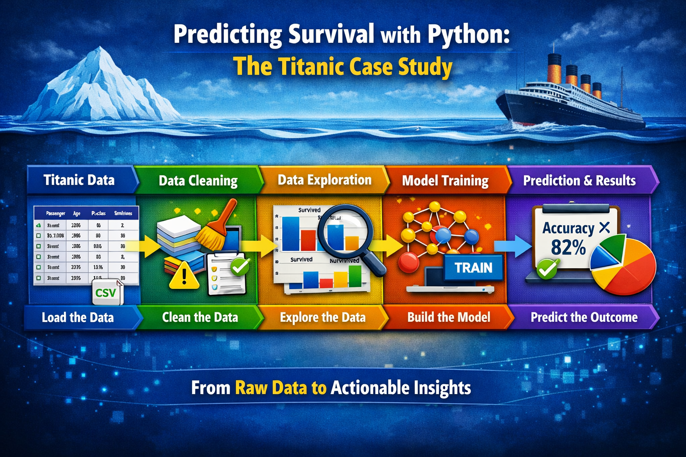
SUMMER INTERNSHIP ON AI & ML 2026

Slide 30
SUMMER INTERNSHIP ON AI & ML 2026
Titanic Data (📊): Show the dataset table with passenger details. Use pd.read_csv() to load.
Data Cleaning (🧹): Handle missing ages and embarkation values. Stress the importance of clean inputs.
Data Exploration (🔍): Visualize survival by gender/class with Seaborn. Encourage students to interpret patterns.
Model Training (🤖): Build a logistic regression model with Scikit‑Learn. Explain classification basics.
Prediction & Results (📈): Display accuracy score (e.g., ~82%). Discuss how features influence survival.
“This case study shows how Python libraries integrate seamlessly — from raw CSVs to predictive models — turning history into a learning tool.”

Slide 31
SUMMER INTERNSHIP ON AI & ML 2026
Title: From Data to Discovery — Lessons from the Titanic Project
Python’s Power in Data Science
Unified ecosystem: NumPy, Pandas, Matplotlib, Seaborn, Scikit‑Learn.
Seamless workflow from data collection to prediction.
Real‑world relevance — from Titanic survival to space‑mission analytics.
The Data Science Mindset
Ask the right questions before coding.
Clean data is the foundation of truth.
Visualize to understand, model to predict, communicate to inspire.
Insights from the Titanic Case Study
Gender and class strongly influenced survival.
Data reveals human stories behind numbers.
Predictive analytics transforms history into foresight.

Slide 32
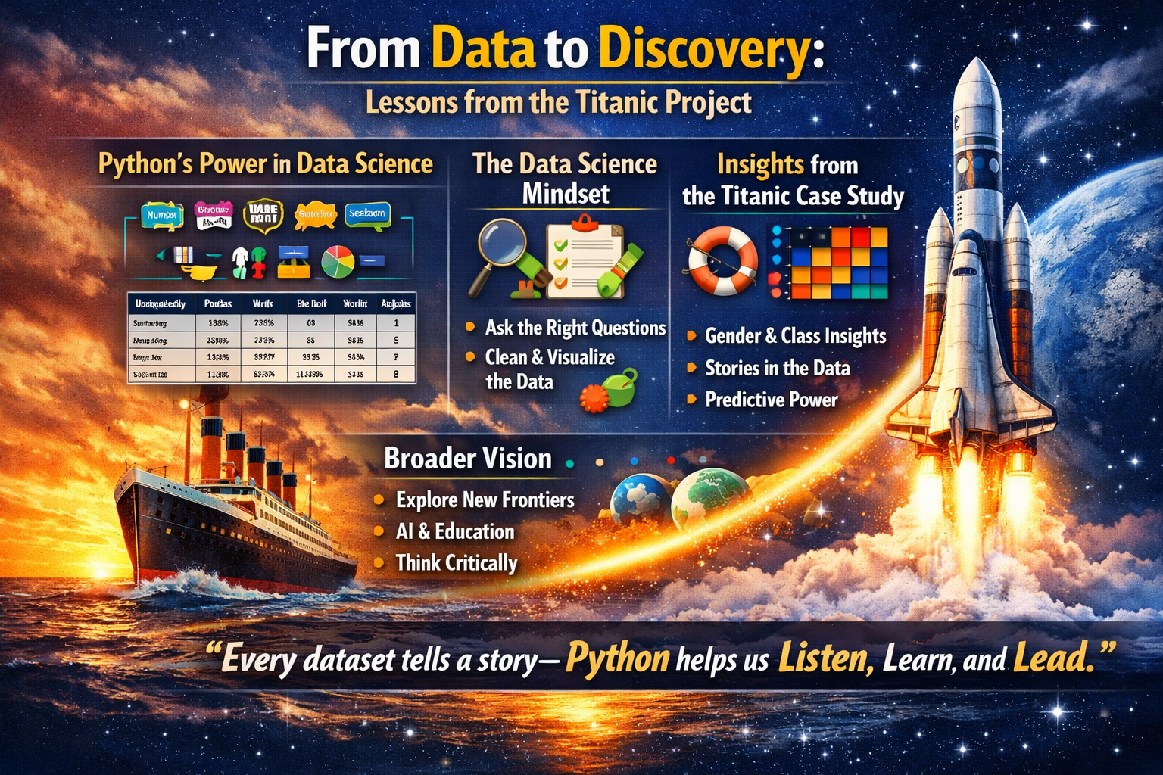
SUMMER INTERNSHIP ON AI & ML 2026
Python’s Power in Data Science: Unified tools, real‑world applications, seamless workflow.
Data Science Mindset: Ask, clean, visualize, model, communicate.
Titanic Insights: Gender and class shaped survival; data reveals human stories.
Broader Vision: Extend lessons to AI, education, and space exploration.
“Every dataset tells a story — Python helps us Listen, Learn, and Lead.”

Slide 33
SUMMER INTERNSHIP ON AI & ML 2026
Key Reflections
Python transforms raw data into meaningful insight.
From Titanic survival prediction to space‑mission analytics, the workflow is universal.
Data science is not just coding — it’s about stories, questions, and clarity.
Inspiration
Every dataset can be reframed into opportunity and foresight.
Lessons from history guide us toward future exploration.
With science as our compass, the future is brighter, bolder, boundless.
FINALLY
“Every dataset tells a story — Python helps us Listen, Learn, and Lead.”

Slide 34
SUMMER INTERNSHIP ON AI & ML 2026
“As we conclude today’s journey through the Titanic project, we have seen how Python transforms raw data into meaningful insight. From cleaning messy tables to visualizing hidden patterns, and finally predicting survival outcomes, each step reminded us that data science is not just about algorithms — it is about uncovering stories, asking the right questions, and communicating answers with clarity. The Titanic dataset, though rooted in tragedy, has become a timeless classroom for learning how knowledge can emerge from history.”
“Let this lesson inspire us to look beyond numbers and see possibilities. Just as the Titanic’s story has been reborn through data, so too can our own challenges be reframed into opportunities. Whether predicting spacecraft health, decoding solar storms, or guiding the next generation of explorers, Python empowers us to listen, learn, and lead. The ship may have sunk, but the spirit of discovery sails on — and with science as our compass, the future is brighter, bolder, and boundless.”
“Every dataset tells a story — Python helps us Listen, Learn, and Lead.”

Slide 35

SUMMER INTERNSHIP ON AI & ML 2026

